Slide 1

Comharchumann Fuinnimh
Oileáin Árann Teoranta
Aran Islands Renewable Energy Cooperative
Comharchumann Fuinnimh Oileáin Árann
Aran Islands Energy Cooperative

Slide 2
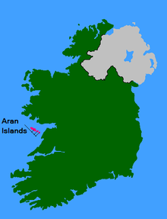
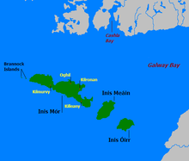
THE ARAN ISLANDS
TOTAL POPULATION 1300
Comharchumann Fuinnimh Oileáin Árann
Aran Islands Energy Cooperative

Slide 3
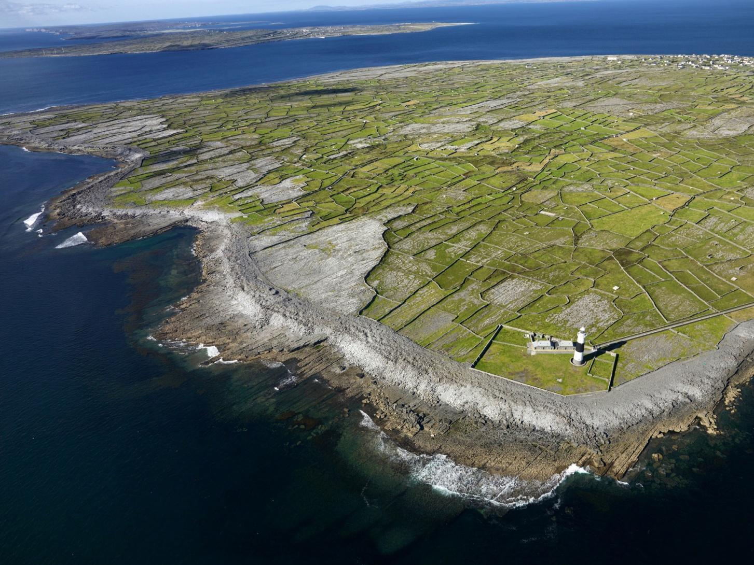
Unique Limestone Landscape
Comharchumann Fuinnimh Oileáin Árann
Aran Islands Energy Cooperative

Slide 4
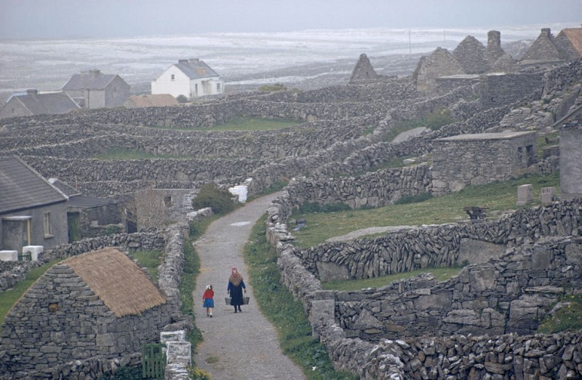
RICH
CULTURE
AND
HERITAGE
Comharchumann Fuinnimh Oileáin Árann
Aran Islands Energy Cooperative

Slide 5
Comharchumann Fuinnimh Oileáin Árann Teoranta
CFOAT
Community owned not-for-profit cooperative
Founded 2012
€100 for life membership
Membership open to all residents and resident businesses
At present over 80 members
Includes all 3 islands: Inis Mór, Inis Meáin, Inis Oirr
Aims to be fossil fuel free and to own its own micro-grid by 2022
Comharchumann Fuinnimh Oileáin Árann
Aran Islands Energy Cooperative

Slide 6
TRANSITION PLAN TO 2022
BUILDINGS
  Energy Efficient, Clean Fueled and Smart Homes and Businesses
TRANSPORT
  Horses and Carriages and Bicycles
  Electric Cars, Buses and Bikes
  Hydrogen fueled Ferries, Fishing Boats and Planes.
GENERATION
  PV and Heat Pumps in Homes and Businesses
  Energy Hub containing Wind Turbines, Solar PV, and Hydrogen creation
Comharchumann Fuinnimh Oileáin Árann
Aran Islands Energy Cooperative

Slide 7
HEAT PUMPS
Comharchumann Fuinnimh Oileáin Árann
Aran Islands Energy Cooperative

Slide 8
SOLAR PV
Comharchumann Fuinnimh Oileáin Árann
Aran Islands Energy Cooperative

Slide 9
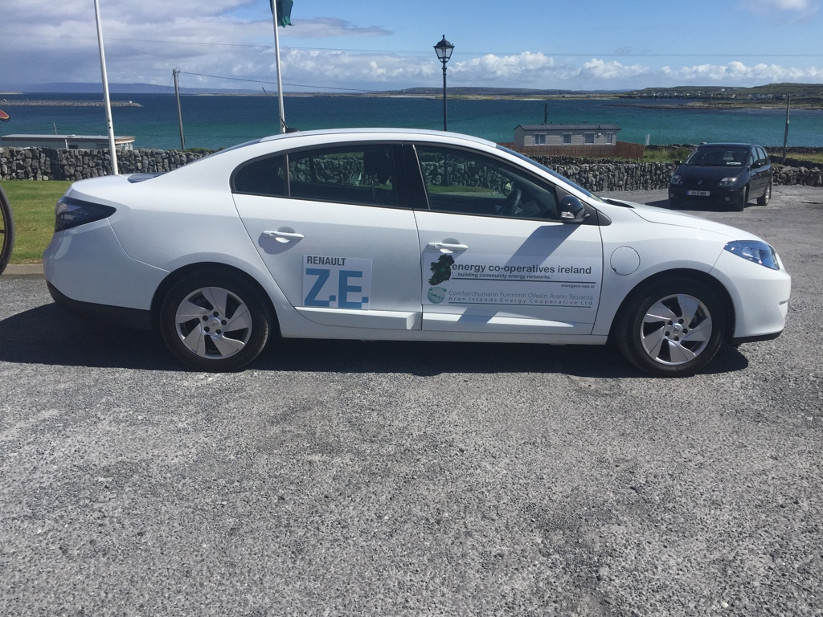
ELECTRIC VEHICLES
Comharchumann Fuinnimh Oileáin Árann
Aran Islands Energy Cooperative

Slide 10
ENERGY HUB: WIND – SOLAR - HYDROGEN
Comharchumann Fuinnimh Oileáin Árann
Aran Islands Energy Cooperative

Slide 11


ONGOING PROJECTS – EU FUNDED
RESPOND : DEMAND - RESPONSE SMART METERING IN HOMES
SEAFUEL: HYDROGEN FUEL FOR ISLANDS IN EUROPE
GEOFIT
GEOFIT: GEOTHERMAL GROUP HEATING SCHEMES
COMMUNITY POWER: COMMUNITY VIRTUAL POWER PLANTS
Comharchumann Fuinnimh Oileáin Árann
Aran Islands Energy Cooperative

Slide 12

ONGOING PROJECTS – AT HOME
Master Energy Plan - Completed
Better Energy Communities - 2019
SEC Funding application 2019
Public support campaign for wind turbine project
Now employing our first employee
Comharchumann Fuinnimh Oileáin Árann
Aran Islands Energy Cooperative

Slide 13
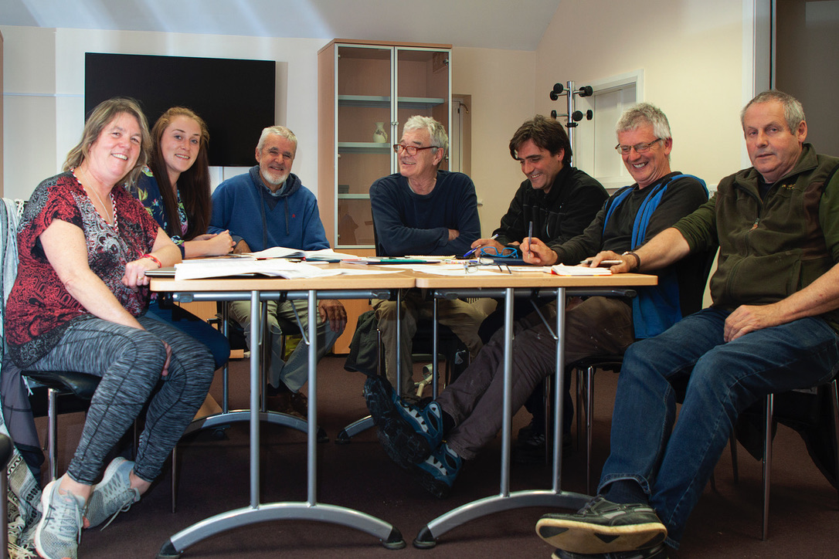
OUR COMMITTEE (not all!)

Slide 14

Comharchumann Fuinnimh Oileáin Árann Teoranta
Aran Islands Renewable Energy Cooperative
WEBSITE
Website: www.aranislandsenergycoop.ie
FACEBOOK
www.facebook.com/aranislandsenergy
TWITTER
@aranislandsenergy
EMAIL
comharchumannfuinnimh@gmail.com
TAKE THE ENERGY TOUR
www.facebook.com/AranIslands.EcoTours
PHONE
Avril Ní Shearcaigh 087-4158419
Dara Ó Maoildhia 087-2795642
Comharchumann Fuinnimh Oileáin Árann
Aran Islands Energy Cooperative

