Slide 2

Energy Cooperatives in Europe: Examples from the LECo Project Partners
18th October 2018
Dr Orla Nic Suibhne
Western Development Commission

Slide 3

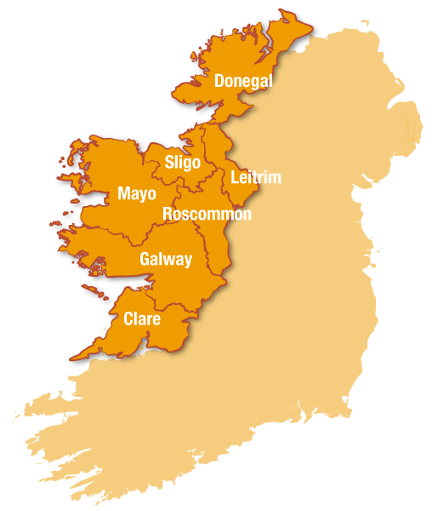
Western Development Commission
State agency who are adapting & leading change
Today the WDC is working with regional, national and international partners to enable job and enterprise growth in the Western Region
  Renewable energy research
  Access to finance: Western Investment Fund
  Insight and analysis: Policy Team
  Regional Development Team
  Creative economy projects

Slide 4
WDC: LECo
Local Energy Communities (LECo) - http://leco.interreg-npa.eu/
NPA 3-year project which commenced in August 2017, budget €1.9m
Based on community energy & development of sustainable energy communities
Lead partner is Centria University of Applied Science in Finland
Partners in Germany, Norway, Finland, Sweden and Ireland
The Local Energy Communities (LECo) will be based either as municipal enterprises or as a cooperative.

Slide 5
LECo – WDC activities
PESTLE analysis to Identify the barriers to community energy projects (Complete)
Report on Best Practice Legal Framework / Ownership for Community Energy (In progress)
Report on Financing of Community Energy Projects (In progress)
Energy Village Feasibility Studies (6 in total in Ireland)
Preparation of Factsheets & Best Practice Case Studies (2019)
Study Tour to Germany: November 2018 (40 community members)
Online training platform (Going Live 2019)
Energy Efficiency Training Webinars ( Going Live 2019)

Slide 6
GERMANY

Slide 7
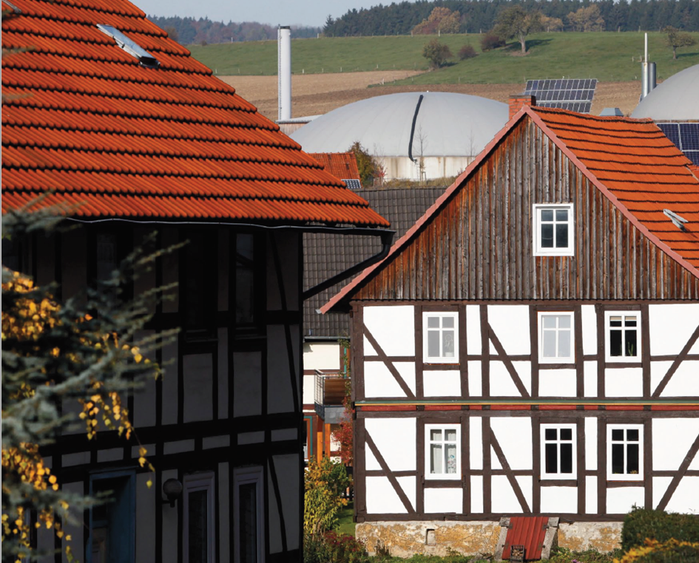

Energy cooperatives in Germany
855 Energy Cooperatives
financed through German
cooperative banks since 2006
Involves 183,000 inhabitants
as members
Members own €682m capital
shares
Average share of €3,729
Carried out total investment of
€2.5bn

Slide 8
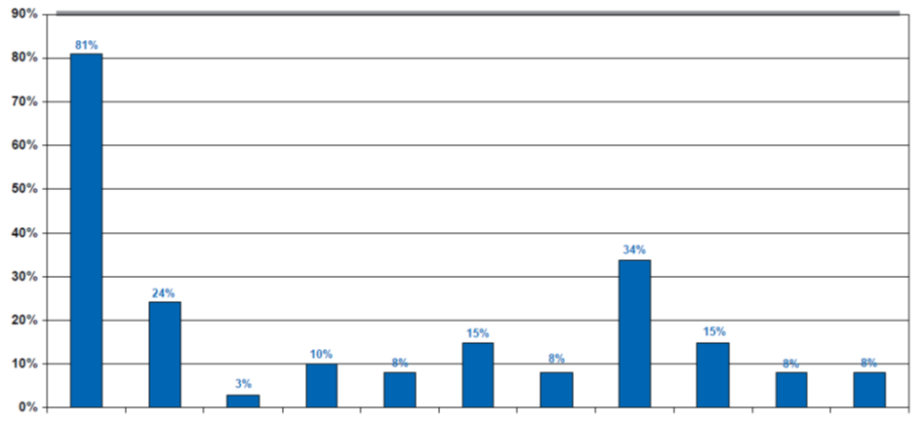
Business Fields
PV – Energy Production
Wind- Energy Production
Biogas Energy Production
Biomass (Wood) Energy Production
Other Energy Production (CHP,
Geothermal, Water)
Heat Distrution by local DH grid
Energy Storage
Sales of grid services and products
Energy Consultancy and Contracting
E- mobility
Energy efficiency
Percentages are in relation to all 855 Energy Cooperatives. They cannot be summed up since various Cooperatives are active in different business fields.
Lions Share is Energy production with PV modules due to a profitable system of feed- in tarifs until 2014. This business modell is guaranteed for 20 years after investment. After change of the Renewable Energies Act the founding of Energy Cooeratives decreased dramatically.
1
2
3
4
5
6
7
8
9
10
11

Slide 9
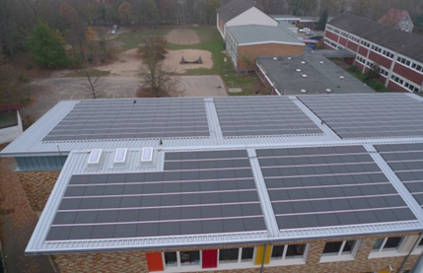
Business Case of a PV - Cooperative
”Bürgersolarkraftwerk Ritterhude”
(Citizen Solar Power Plant Ritterhude)
Municipality offers roof
surface of public building
(in this case public school)
Municipality sells shares to
local citizens
Local utility buys power with
subsidized prices
Utility resells it to national
system and receives guaranteed
price
Municipality owns part of
modules to cover energy
consumption for school house
and saves money due to lower
price for electricity by own
production
Capacity of this plant:
64.4 kWp

Slide 10
FINLAND

Slide 11
Finland- Cooperatives
Long history with coop model: 5000 in 2015 (employ 17% of population, biggest in the world)
103 renewable energy coops in 2015 (no wind or solar mostly bioenergy for DH and biogas)
The coop has proven to be a good form of conducting business
Decision-making has been collectively in the hands of the members
The co-op board actively leads the organization, but all members are kept up to date, and are continually informed about new projects

Slide 12
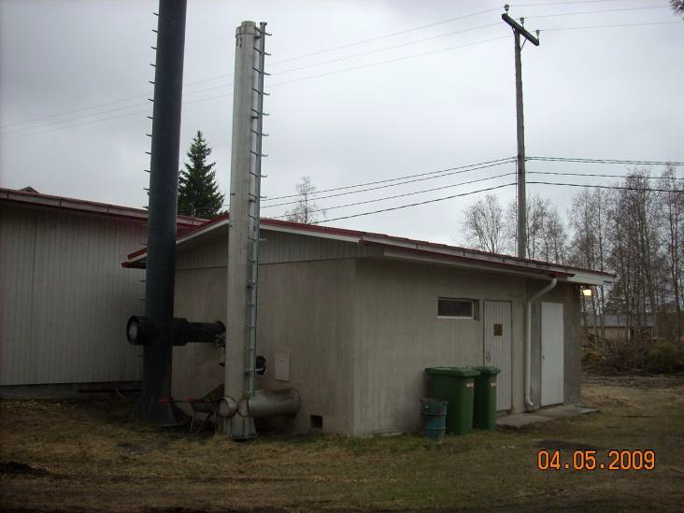
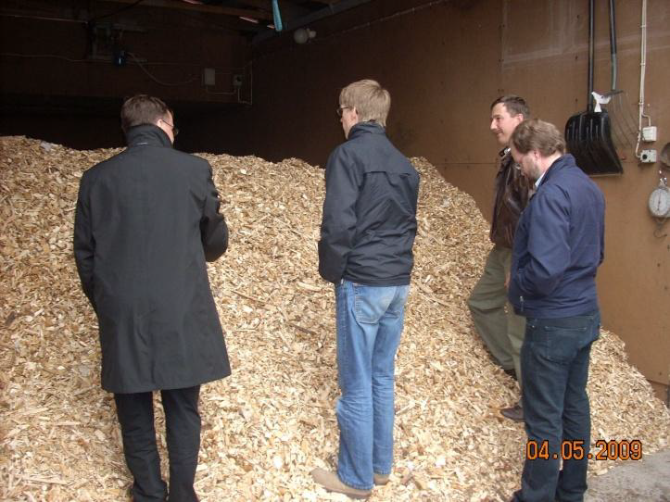
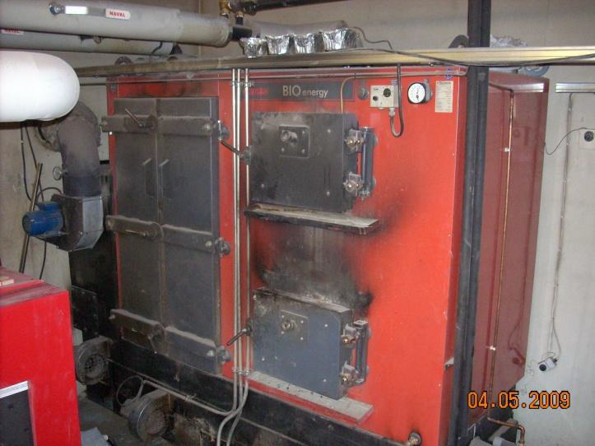
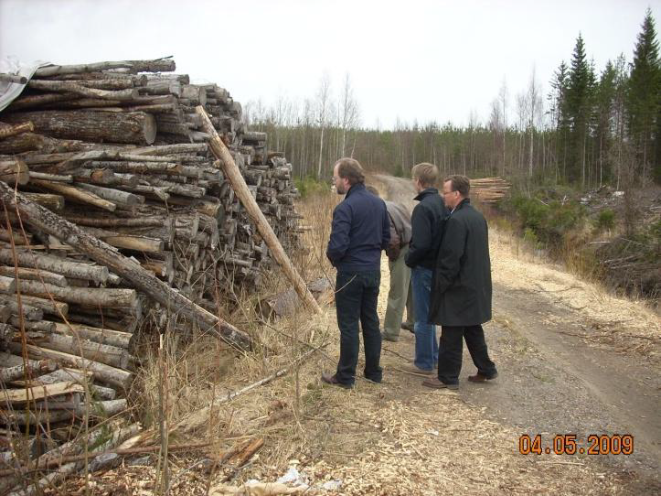
Finland- Lohtaja Cooperative (LECo partner)

Slide 13
SWEDEN

Slide 14
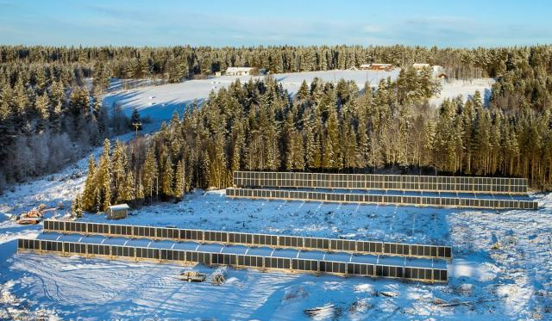
PV cooperative Näversjön
Näversjön: 15 members
Production: ca 85.000 kWh/yr
Shares of 1000 kWh
Cooperate with an electricity company. Members can buy electricity at a cheaper price from that company equivalent to their shares, remaining to ”normal” price.
Frames built by the villagers
Cost: 1 Million SEK (€96.5k) incl VAT, but VAT refunded to the cooperative
Investment subsidy: 35%
Cooperative income by electricity certificates

Slide 15
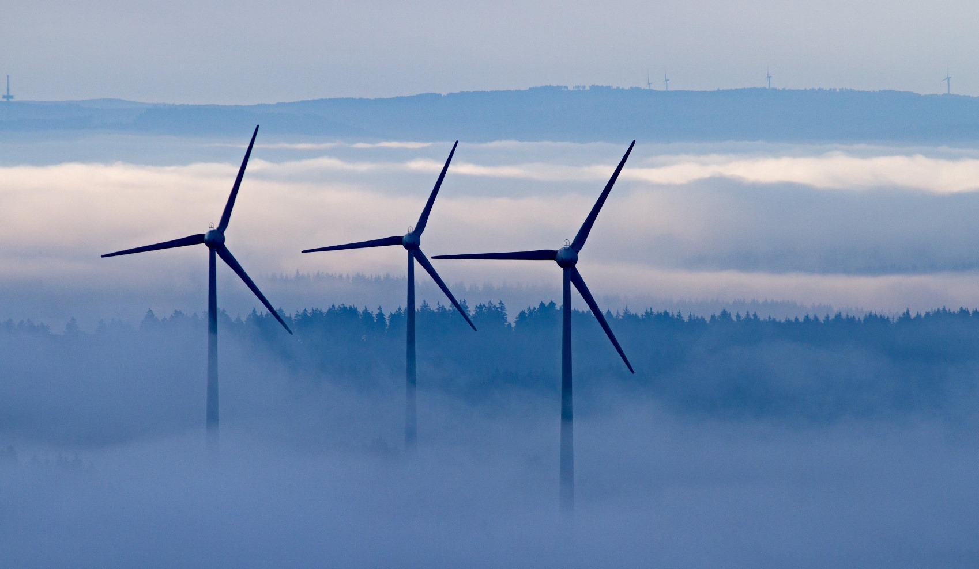

Swedish Windpower Cooperative
10 windpower plants owned by SVEF
Members buy shares of 1000 kWh to become a member of SVEF
SVEF sells all produced electricity and buys back as much as members use
Cooperate with an electricity company. Members can buy electricity at a cheaper price from that company equivalent to their shares, remaining at ”normal” price.

Slide 16
^{The Project Partners}
Centria University of Applied Sciences (Lead Partner) (FIN), Lohtaja Energy Cooperative (FIN),
Western Development Commission (IRL), The Gaeltacht Authority (IRL), Luleå University of Technology (SWE),
Jokkmokk Community (SWE), Arctic University of Norway (NOR), Renewable Energies Agency (GER)

