Slide 1
Communities and the Low Carbon Transition
Declan Meally
Head of Department

Slide 2





Overview
The Champion
The SEAI Communities Programme
Structure and Policy linkages
RESS

Slide 3
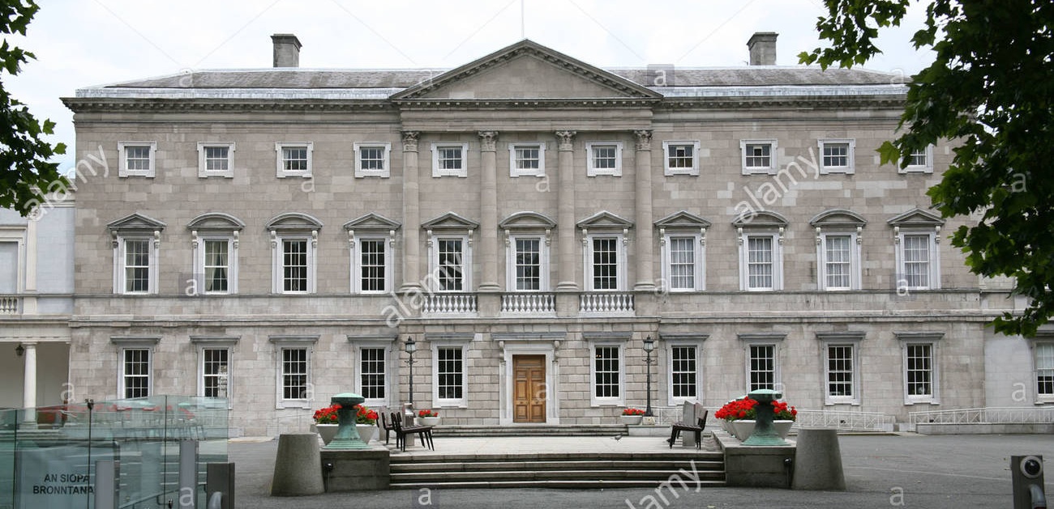
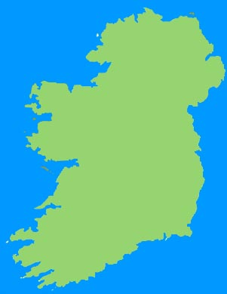
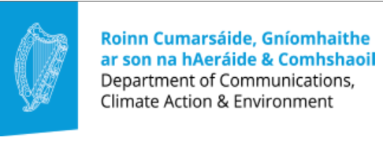
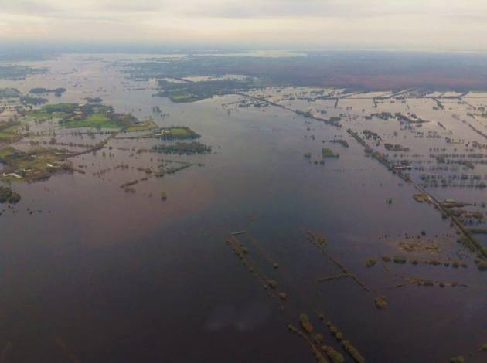
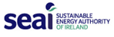
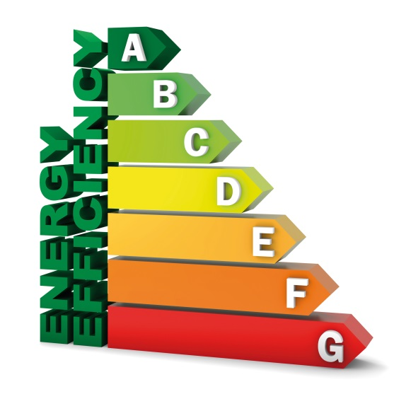

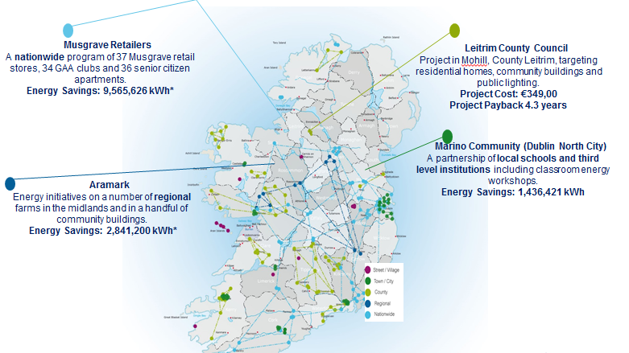
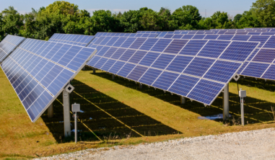

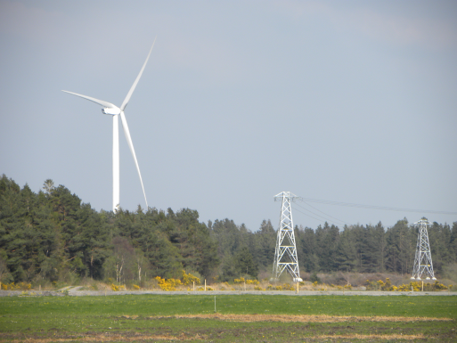
The BIG Picture
Organisational
Management Commitment
People
Developing an energy efficient culture
Technical
Understanding how and where energy is used

Slide 4
The Champion
Organisational
Management Commitment
People
Developing an energy efficient culture
Technical
Understanding how and where energy is used
The
Chanpion

Slide 6
DOMESTIC challenges
Heat – Renewable Heat challenges and the Electricity conundrum
Electricity – Renewable Electricity /Utility Market and Grid Development
Transport – Modal Shift and Infrastructure
Societal – Education, Social acceptance of energy infrastructure

Slide 7

Communities at the heart of the Low Carbon Transition

Slide 8



How we define a community
A Sustainable Energy Community (SEC) is a community in which everyone works together to develop a sustainable energy system for the benefit of the community.
This is achieved by:
aiming, as far as possible, to be energy efficient
using renewable energy where feasible
adopt smart technology solutions

Slide 9
History of Community Engagement
Dundalk 2020
BEC Pilot €3M
SEC Network
Community Grants
BEC €55M
2019
2018
2016
2012
2006

Slide 10
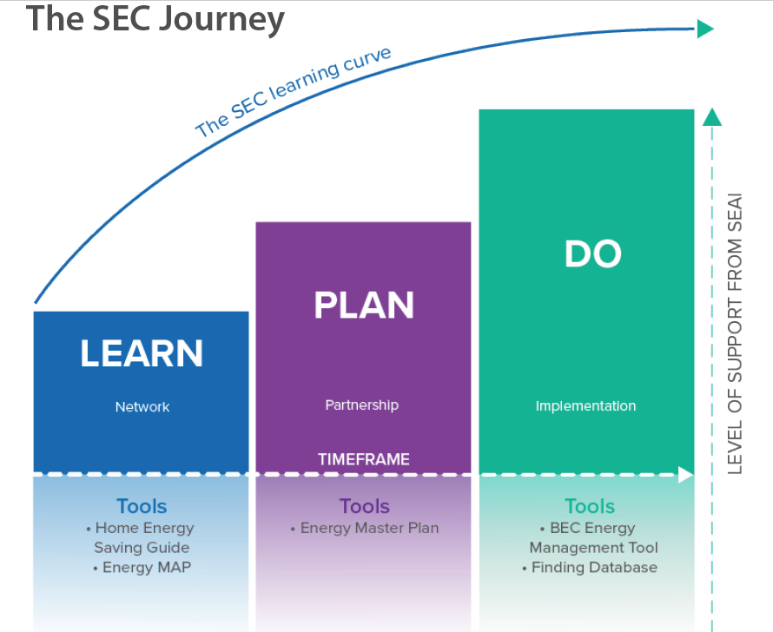
Achievements
The
2012 -2018
17,000 home upgrades
2000 Non domestic upgrades
540 GWh saved
€300 Million Invested
€125 Million in support from
202 Network Members
51 Energy Master Plans
54 Community Projects

Slide 11
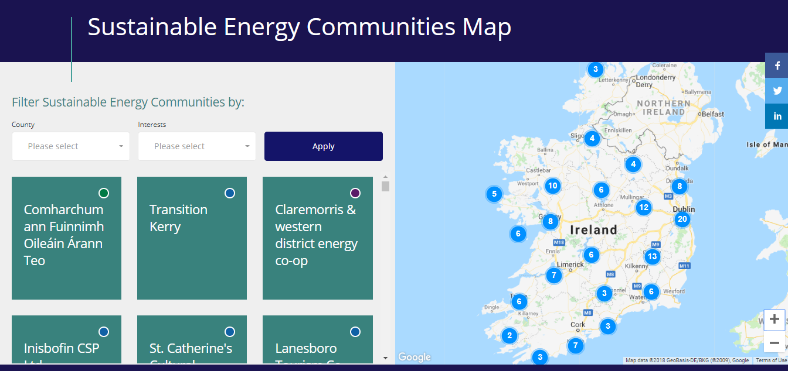

Slide 12
SEAI Supports
The “Learning and Planning” Part
Raise awareness
Build competency
The “Do” Part
Capital funding
Share learnings
Develop energy plan
Engage communities
National network
€25 million in 2017
Community impact
Finds solutions
Builds partnerships
Always open
Shorter timeframe
Competition

Slide 13
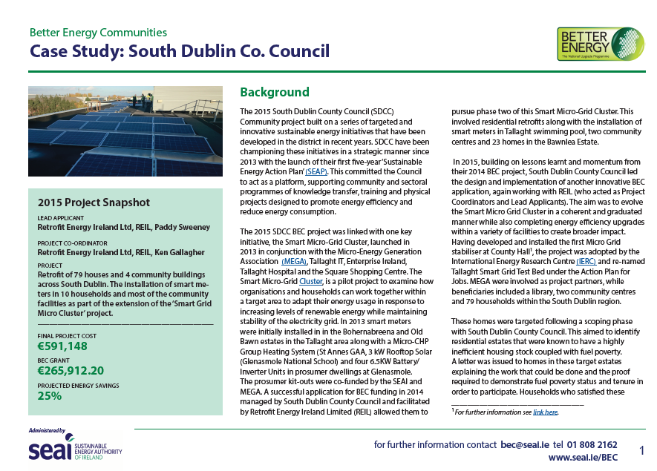
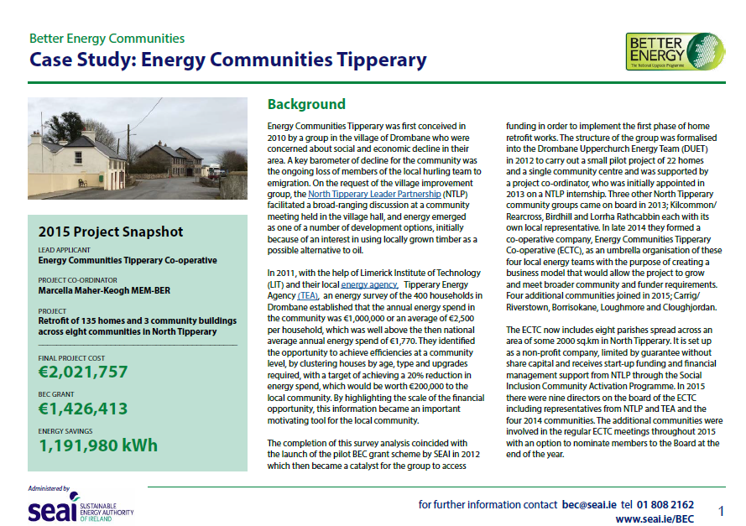
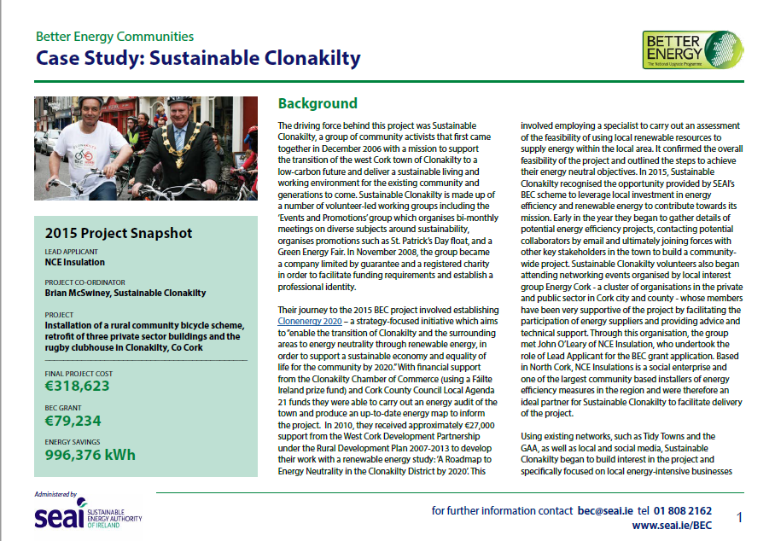
Do Step

Slide 14
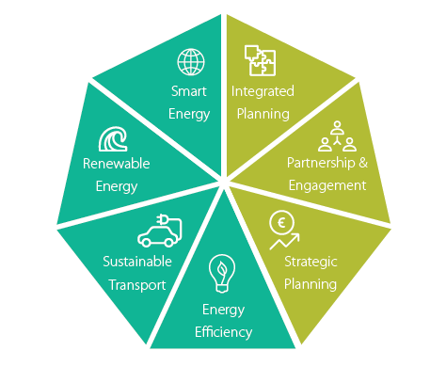
Mentor and Technical Supports
Free mentoring service
Regionally based
Annual reviews
Technical Panel
Training
Regional Events
Site visits

Slide 15
Communities
LARES
Smart Grid
Schools
Public Sector
SME Grants
Warmer Homes
RD&D
BEH
Evs
Deep Retrofit
EXEED
BEU
Ocean
Broader
Supports

Slide 16
SECs Delivering on National and European Policy
EU Energy Transition Directives
National
Energy Efficiency Action Plan
Action Plan for Jobs
Regional Action Plan for Jobs
Rural Development Programme
Local Economic and Community Plans
GLOBAL
HORIZON 2020
EIB
National Energy Targets
Ireland as Europe’s Energy Innovation Hub (by 2020)
Climate Action Fund
Local Government Reform Act – Putting People First
Cross sectoral innovation needed within each region to drive new job-creation strategies and projects.
Sustainable Energy Action Plan (SEAPs
Community Grants;
Leader Funding
Community Development Funds
Local Economic + Community Plans (LECPs)
SEC
Local Authority Renewable Energy Strategy (LARES)
LOCAL

Slide 17
Developing
Structure
Regional Committees
Community Members
(+10,000)
Network Members
(214)
National
Reps

Slide 18
Links with RESS
The
Communities have been investing in energy efficiency
Now turning towards investing in renewables
RESS provides an opportunity for community scale renewable investment
New partnerships emerging locally
International models for share ownership can be adopted.
Needs leadership and simple processes

Slide 19


